Slide 1
MOTHER TERESA
Biography

Slide 2
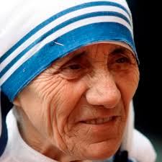
Mother teresa

Slide 3
BIOGRAPHY OF MOTHER TERESA
Who is Mother Teresa?
Mary Teresa Bojaxhiu (born Anjezë Gonxhe Bojaxhiu, 26 August 1910 – 5 September 1997), commonly known as Mother Teresa and honoured in the Catholic Church as Saint Teresa of Calcutta,^{[7]} was an Albanian-Indian^{[4]} Roman Catholic nun and missionary.^{[8]} She was born in Skopje (now the capital of North Macedonia), then part of the Kosovo Vilayet of the Ottoman Empire. After living in Skopje for eighteen years, she moved to Ireland and then to India, where she lived for most of her life.

Slide 4
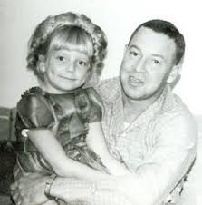
family
Father of mother teresa :nikola

Slide 5
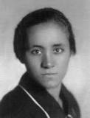
Mother name Dranafile.

Slide 6
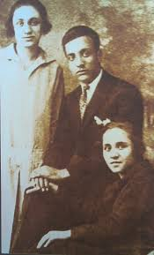
Siblings
Brother name:Lazar
Sister Name:Aga

Slide 7
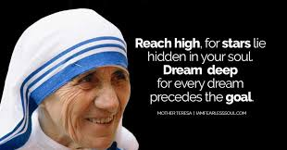
Quotes of Mother Teresa

Slide 8
Signature of mother teresa

Slide 9
V.Bavan pratheesh V-B
Thank you

